Slide 1
Getting Things Done
Staying organized in an “information overload” environment

Slide 2
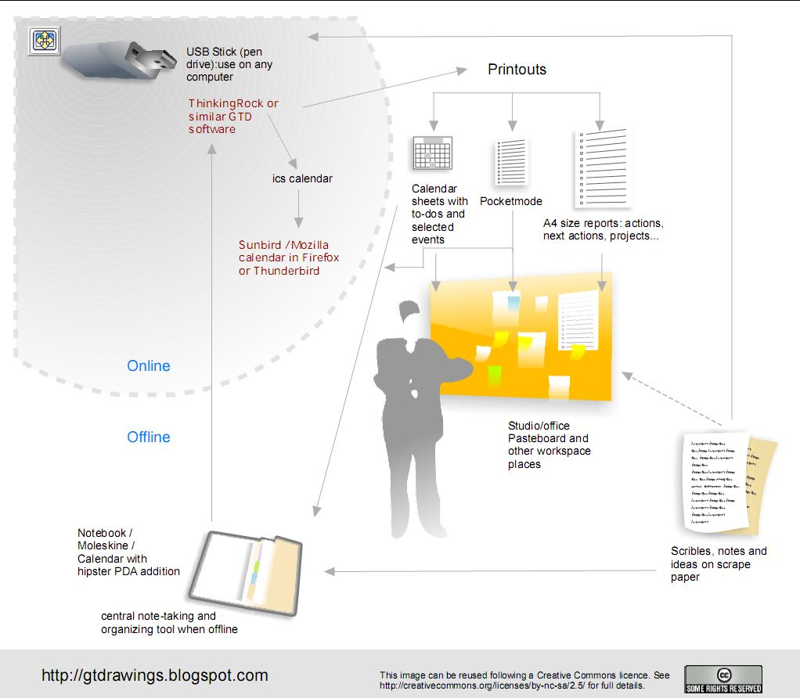
Workflow

Slide 3
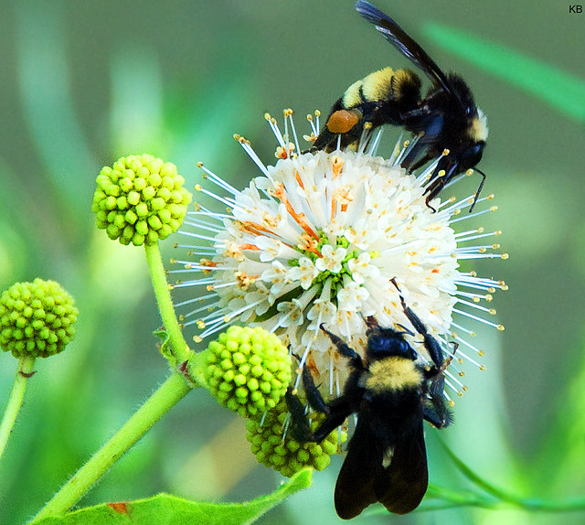
Collect
Photo courtesy krikit

Slide 4
Collect: Get Everything Out of Your Head
Photo Courtesy impactmatt

Slide 5
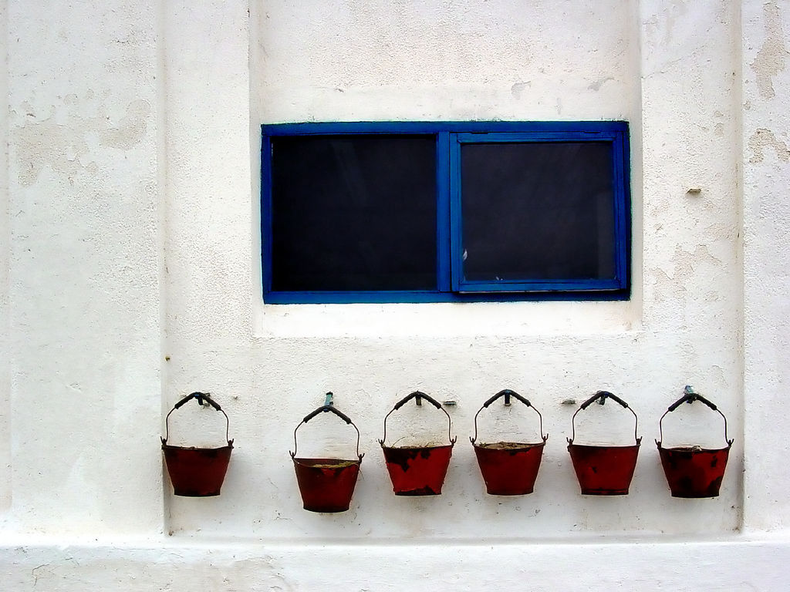
Collect: Minimize the collection buckets
Photo courtesy funari

Slide 6
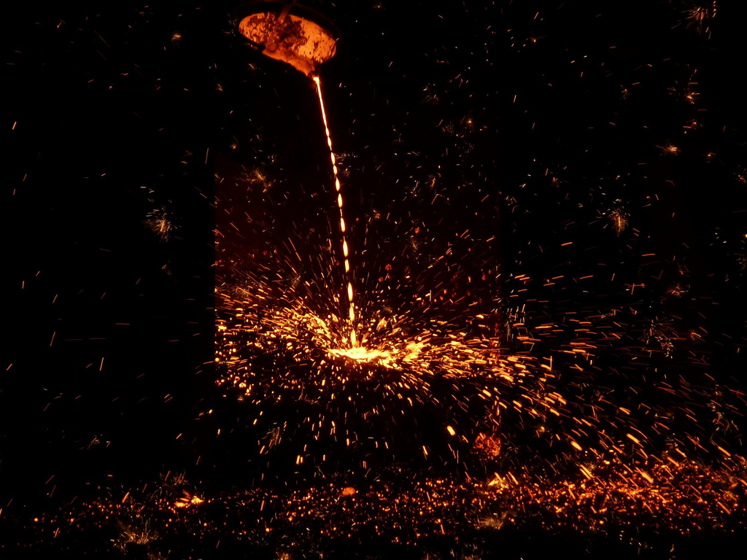
Collect: Empty the buckets regularly
Photo courtesy timony

Slide 7
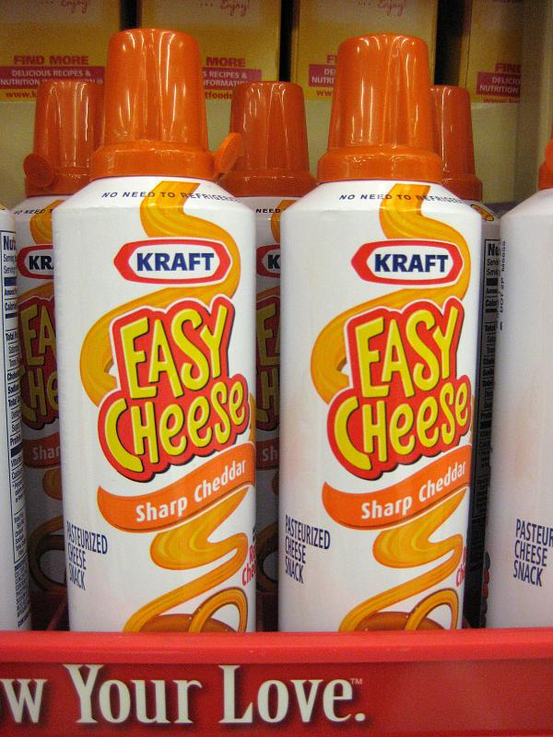
Process
Photo courtesy carol_green

Slide 8
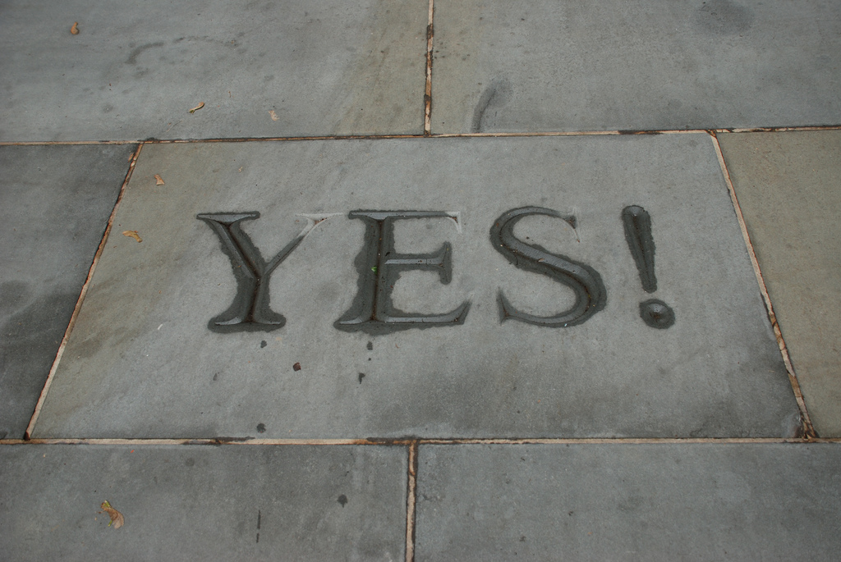
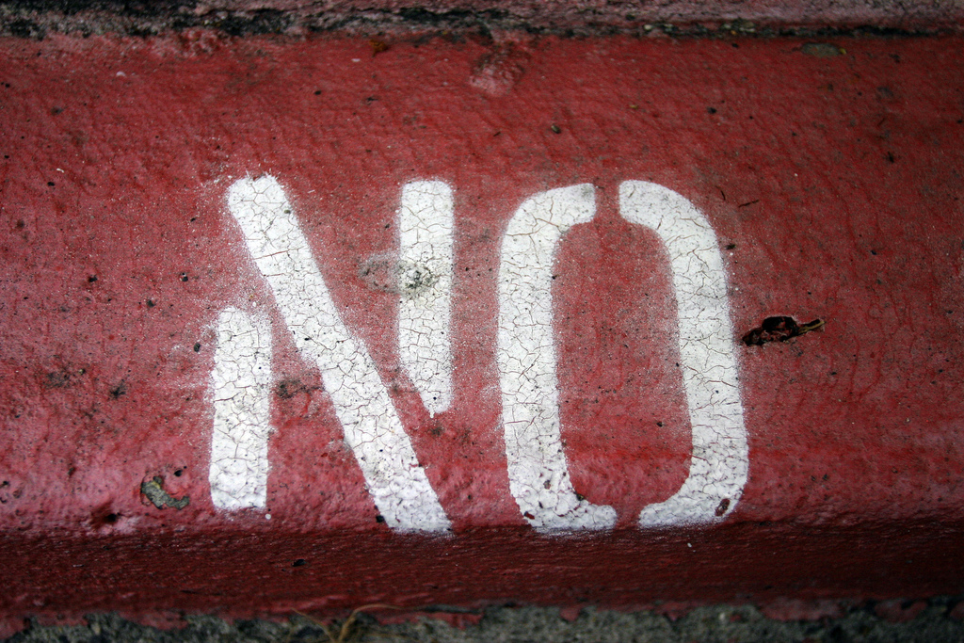
Process: Are the items actionable?
Photo courtesy joeshlabotnik
Photo courtesy nathangibbs

Slide 9
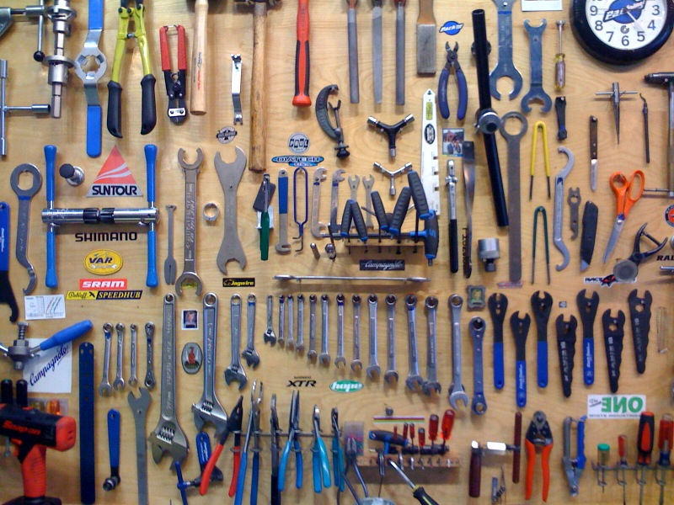
Organize
Photo courtesy melissadion

Slide 10
Review
Photo courtesy elephipelephi

Slide 11
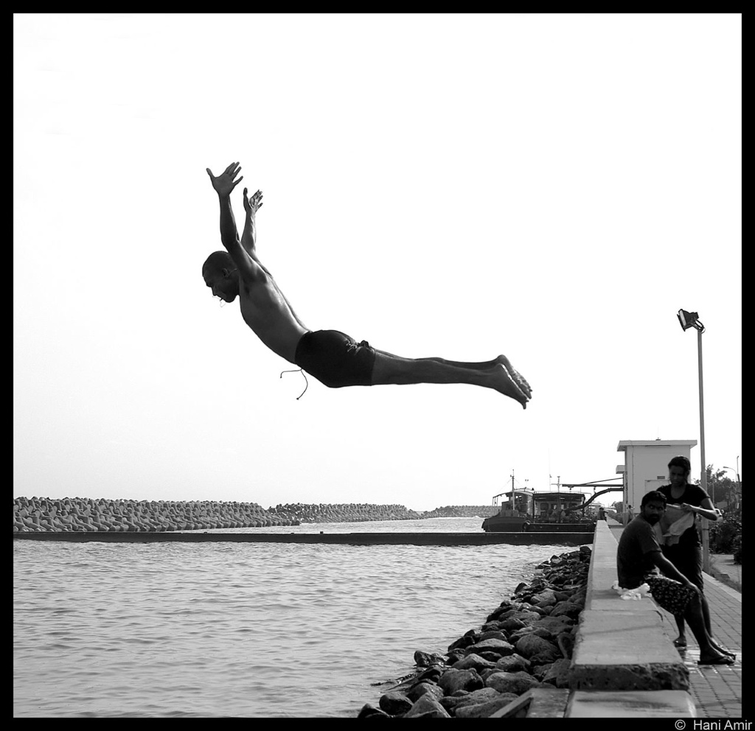
Do
Photo courtesy haniamir

Slide 12
Getting Things Done
Charlie and Andy’s systems

