Slide 1
Learning Analytics
Leading from the classroom - March 29th, 2012

Slide 2
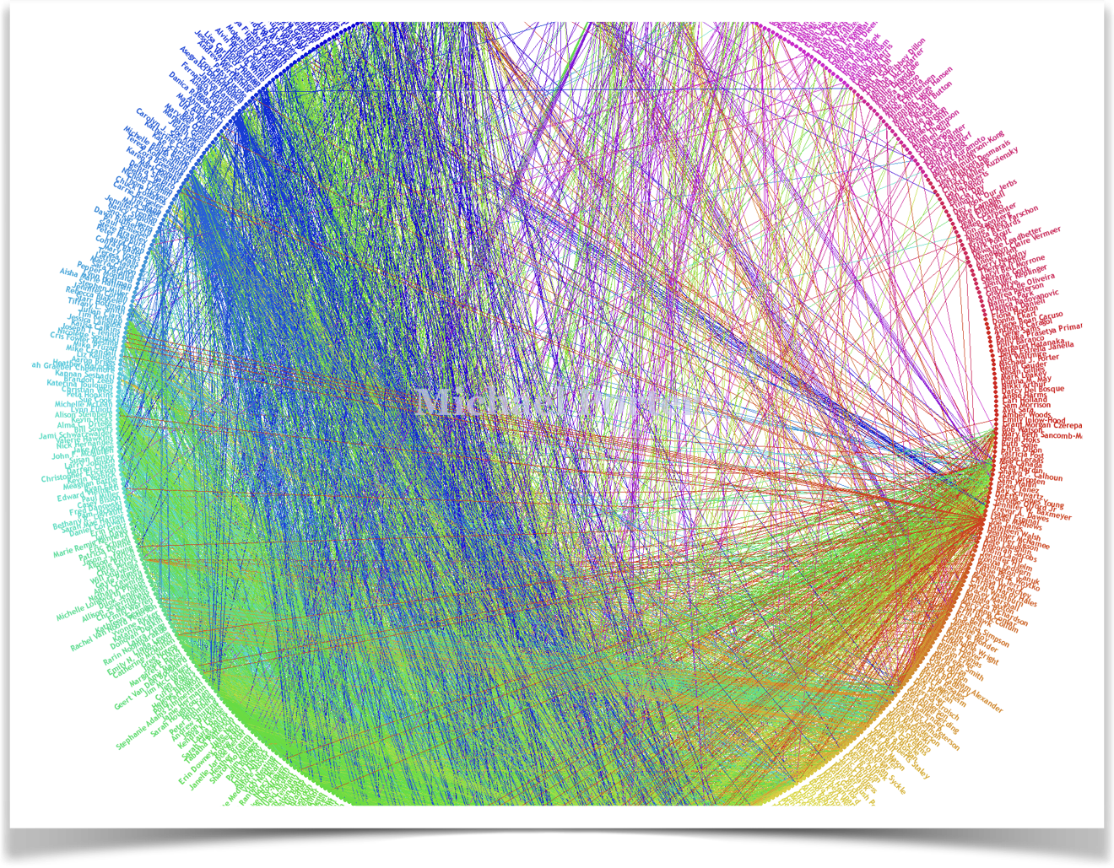
Big Data
"Every two days now we create as much information as we did from the dawn of civilization up until 2003", Eric Schmidt CEO of Google
Notes:
According to Mashable (independent online news site dedicated to covering digital culture, social media and technology), the world’s information is doubling every two years.

Slide 3

Educational Data Mining

Slide 4
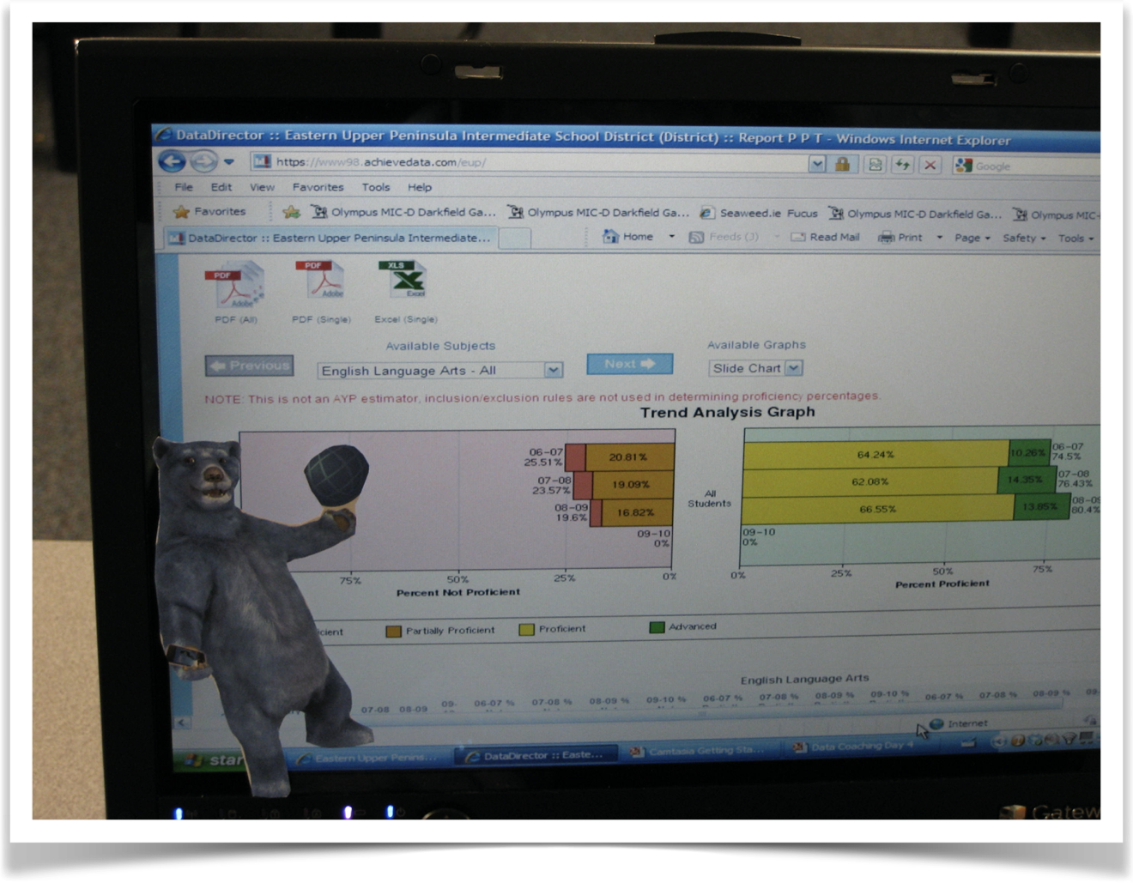
Educational Data Mining

Slide 5
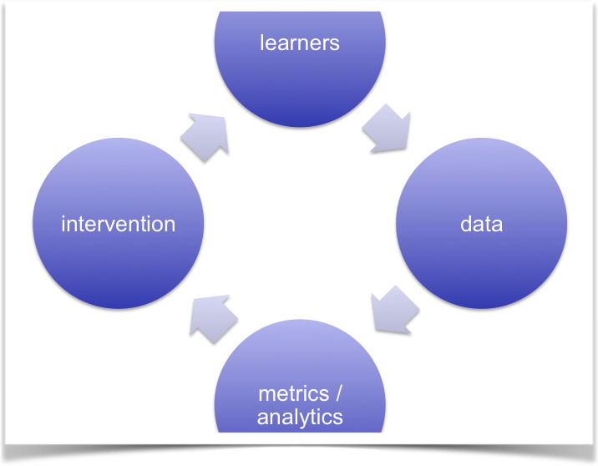
Learning Analytics

Slide 6
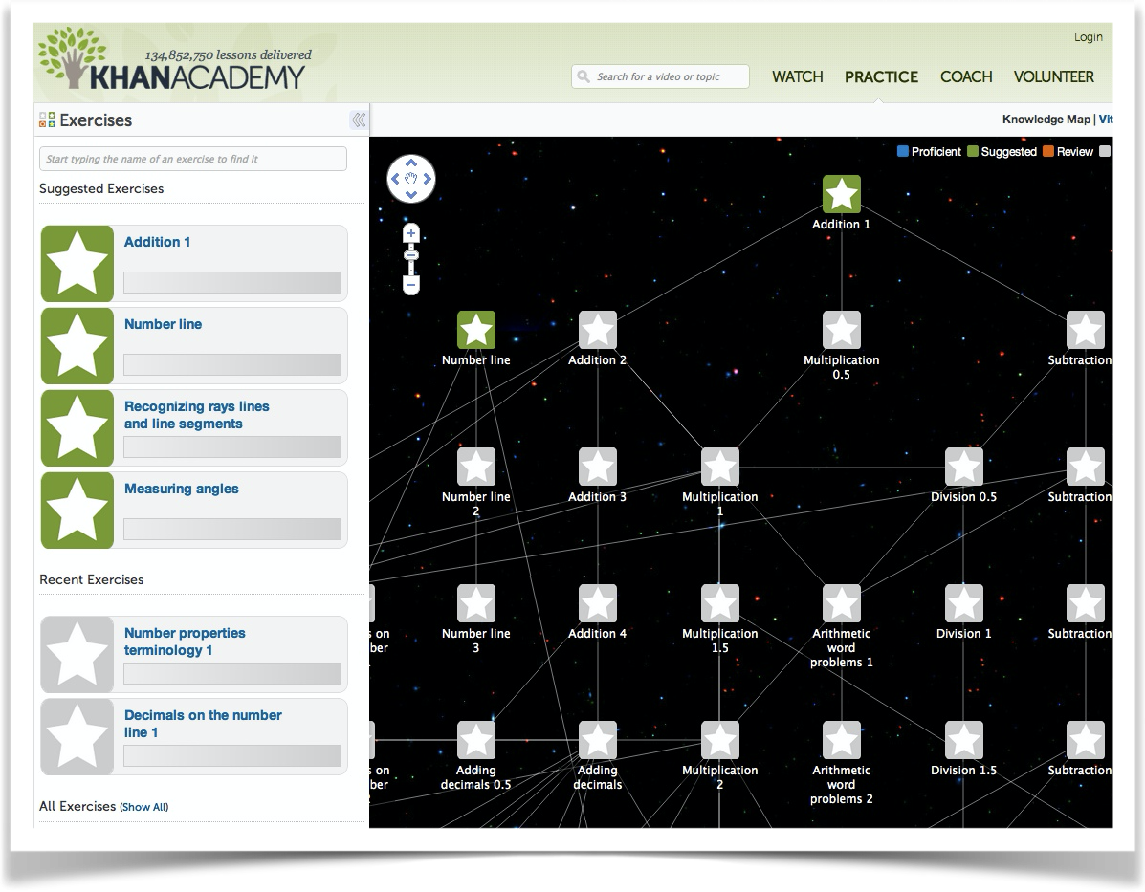
Khan Academy

Slide 7
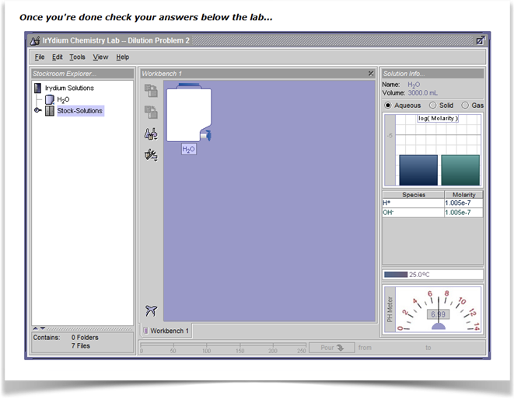
Carnegie Mellon OLI

Slide 8
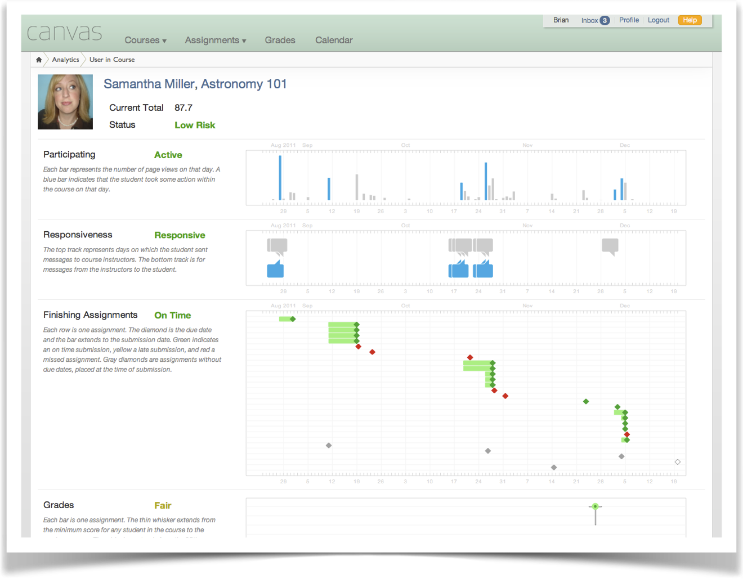
Canvas analytics

