Slide 1
ctcLink Update
Advising and Counseling Council - April 30, 2015

Slide 2
College Activities
Data Conversion/Validation Cycle 8
Payroll Parallel Testing
System Testing
Training
Business Process Decisions and System Familiarity

Slide 3
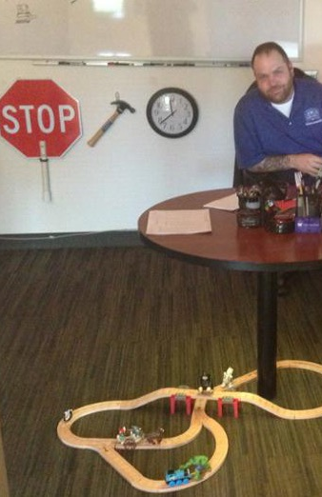
Program Plans
Crosswalk will de-activate all but latest plan during conversion
Students will need to review plans for accuracy after Go Live

Slide 4
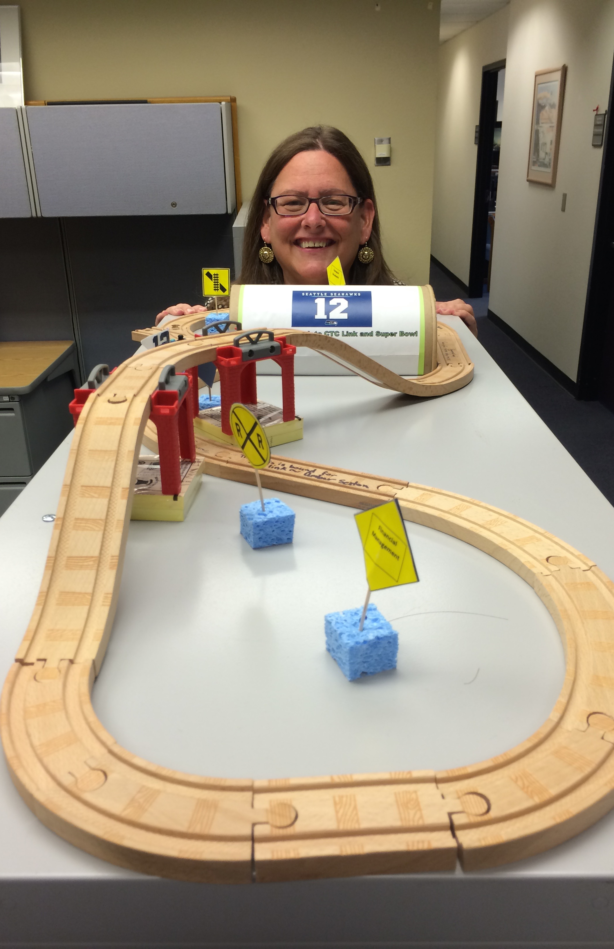
Early Alert CEMLI
Development Complete
Currently in Testing

Slide 5
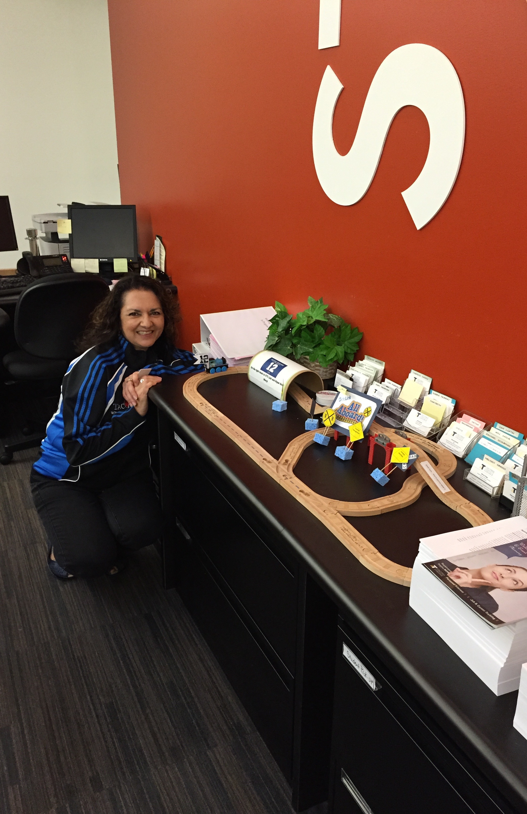
Supporting Systems
Performed Initial Audit to Determine Systems to Keep
Need to pull data from ctcLink to populate
Advisor Dashboard

Slide 6
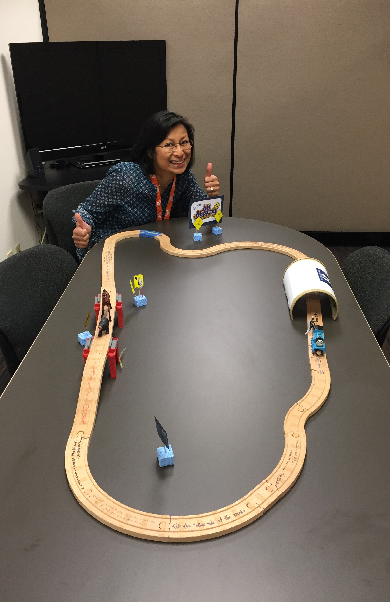
ctcLink Gateway and Campus Portals
Separate Logins Initially

Slide 7
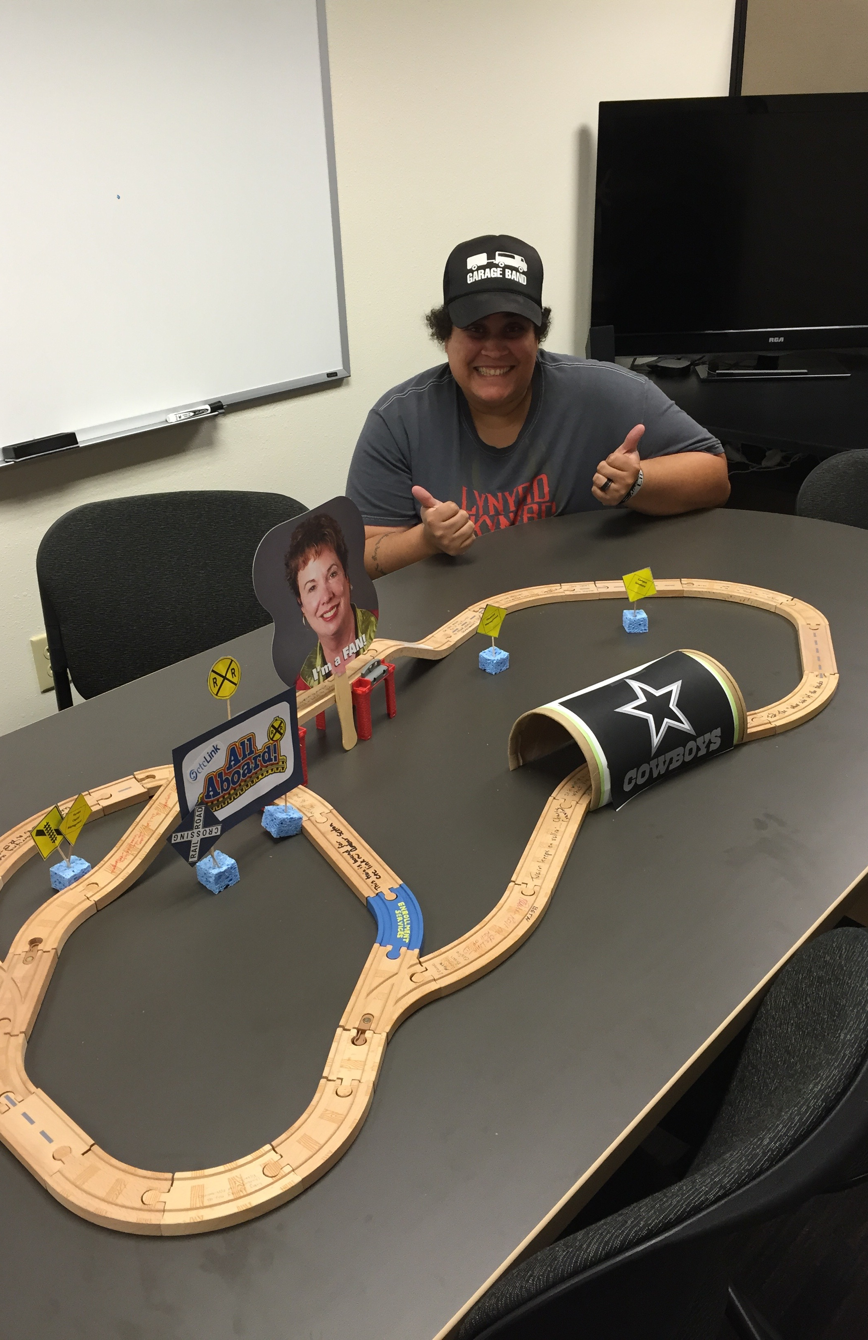
Highpoint Mobile Message Center
Messaging for Mobile Devices
Integrates with ctcLink 3Cs (Communications, Checklists and Comments)

